Slide 1
Safe and Autonomous Docking of an AUV
Ashish Shukla, Sweta Tripathi and Sanad Shaha
Indian Institute of Science Education and Research Bhopal
ECS 418 - Intelligent Robotics
Term Project
ECS 418 Intelligent Robotics

Slide 2
OUTLINE
1
MOTIVATION
2
LITERATURE REVIEW
3
PRELIMINARY SIMULATIONS
4
FUTURE WORK
ECS 418 Intelligent Robotics

Slide 3
MOTIVATION
Autonomous docking is a fundamental operation in on-orbit servicing, refueling, debris capture, and modular satellite assembly.
These maneuvers must be performed:
Safely — avoiding collisions or misaligned contact,
Precisely — aligning orientation and position,
Robustly — despite sensor noise, actuator limits, and environmental disturbances.
ECS 418 Intelligent Robotics

Slide 4
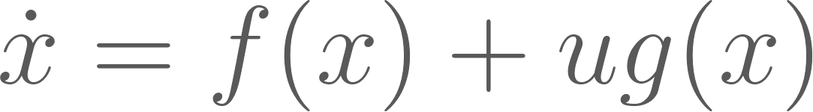
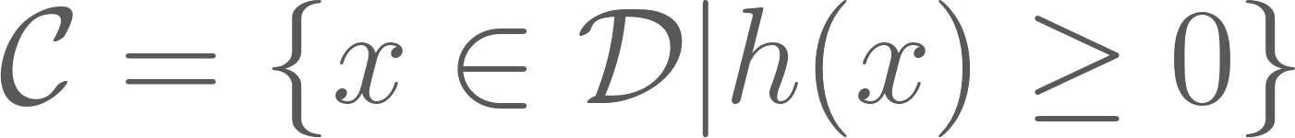


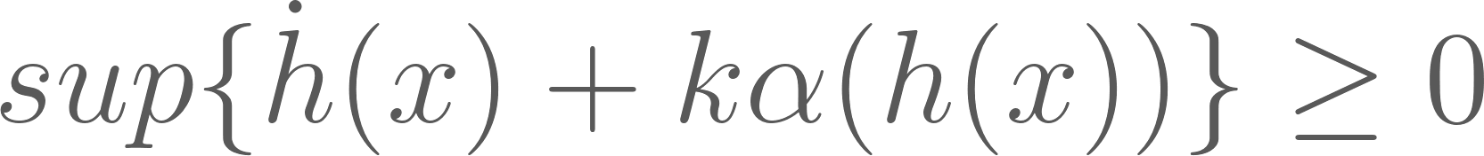
LITERATURE REVIEW
Control Barrier Functions
Here we assume the system to be of affine non-linear control model:
Given a continuously differentiable function h, we define the safe set as
Given , defined by a continuously differentiable function h for x, h is called a CBF if there exists an extended class K function such that
This condition implies that there exists a u that keeps the system within the safe set C (forward invariant).
Ames, A. D., Coogan, S., Egerstedt, M., Notomista, G., Sreenath, K., & Tabuada, P. (2019, June). Control barrier functions: Theory and applications. In 2019 18th European control conference (ECC) (pp. 3420-3431). Ieee.
ECS 418 Intelligent Robotics

Slide 5
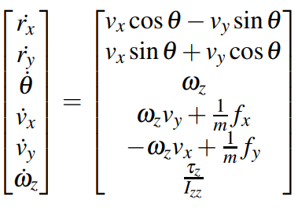
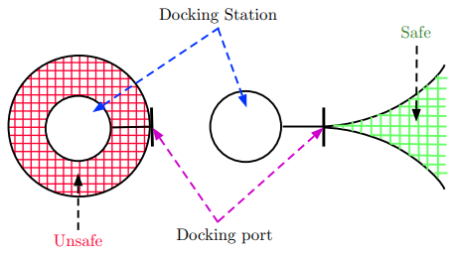
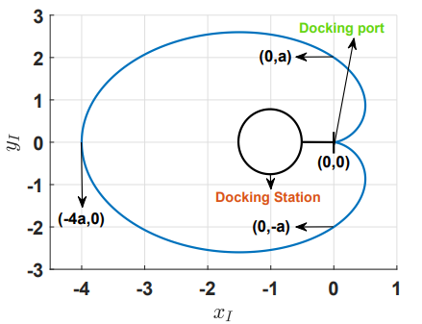
LITERATURE REVIEW
Safe Autonomous Docking of a floating platform
Equations governing the motion of the slider platform are:
where, rx,ry ∈ R describe the position of the Slider with respect to the inertial frame I. The angle θ ∈ S represents the orientation of the Slider with respect to the inertial frame. The linear velocities vx,vy ∈ R, directed along xB,yB and the rotational velocity wz directed along zB, in the body-frame B. The mass of the platform is denoted by m and the forces along xB and yB axes of the body frame are denoted by fx and fy respectively. The Coriolis effects influencing the motion of the Slider feature in the dynamics through the terms wzvy and −wzvx..
Proposed docking maneuver comprises of 3 key features:
Tracking the docking port
Safe Approach to the docking port
Visual lock on the docking port
A. Saradagi, A. Banerjee, S. Satpute, and G. Nikolakopoulos, “Safe autonomous docking maneuvers for a floating platform based on input sharing control barrier functions,” in 2022 IEEE 61st Conference on Decision and Control (CDC), 2022, pp. 3746–3753. Doi: 10.1109/CDC51059.2022.9993109.
ECS 418 Intelligent Robotics

Slide 6

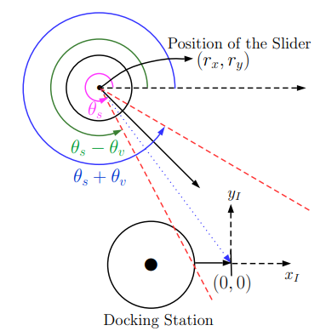
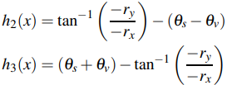
LITERATURE REVIEW
CONTROL BARRIER FUNCTIONS FOR SAFETY AND VISUAL LOCKING:
Barrier function for safety,
Barrier functions for visual locking,
These are the control strategy for safe and autonomous steering of a floating platform, the Slider, to a docking port on a stationary docking station. Control barrier functions (CBFs) were designed to enforce safe distance from the docking station and a correct direction of approach (Cardioid CBF) and a visual lock on the docking port throughout the docking maneuver. Also we have seen that the barrier functions exhibited the control sharing property in establishing positive invariance of the set defining safety and visual locking.
A. Saradagi, A. Banerjee, S. Satpute, and G. Nikolakopoulos, “Safe autonomous docking maneuvers for a floating platform based on input sharing control barrier functions,” in 2022 IEEE 61st Conference on Decision and Control (CDC), 2022, pp. 3746–3753. Doi: 10.1109/CDC51059.2022.9993109.
ECS 418 Intelligent Robotics

Slide 7
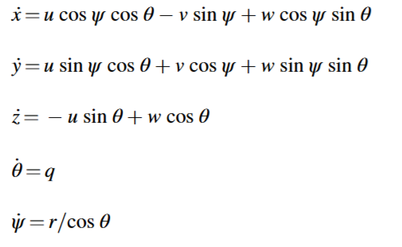
LITERATURE REVIEW
Mobile Docking
AUV model-
Proposed Method-
An observer based sliding mode controller.
A reduced-order linear extended state observer (RLESO) is employed to estimate disturbances caused by water currents.
Where u,v,w are surge, sway and heave velocities in body frame, ѱ, θ is the yaw and pitch, q and r being pitch and yaw angular rate, and x,y,z are the inertial coordinates in inertial frame.
Xie, Tianqi, et al. "Three-dimensional mobile docking control method of an underactuated autonomous underwater vehicle." Ocean Engineering 265 (2022): 112634.
ECS 418 Intelligent Robotics

Slide 8
LITERATURE REVIEW
RLESO vs ESO
FEATURE | ESO | RLESO
Estimated states | All ( measured unmeasured) | Only unmeasured + disturbances
Convergence speed | Slower | Faster
Control Strategy:
Approach Phase-
AUV moves towards a certain point when the docking station is in motion and AUV is far from the station.
Tracking Phase-
AUV estimates the position of the docking station and tracks the desired trajectory when it is close to the docking station
Fu, Caifen, and Wen Tan. "Analysis and tuning of reduced-order active disturbance rejection control." Journal of the Franklin Institute 358.1 (2021): 339-362
ECS 418 Intelligent Robotics

Slide 9
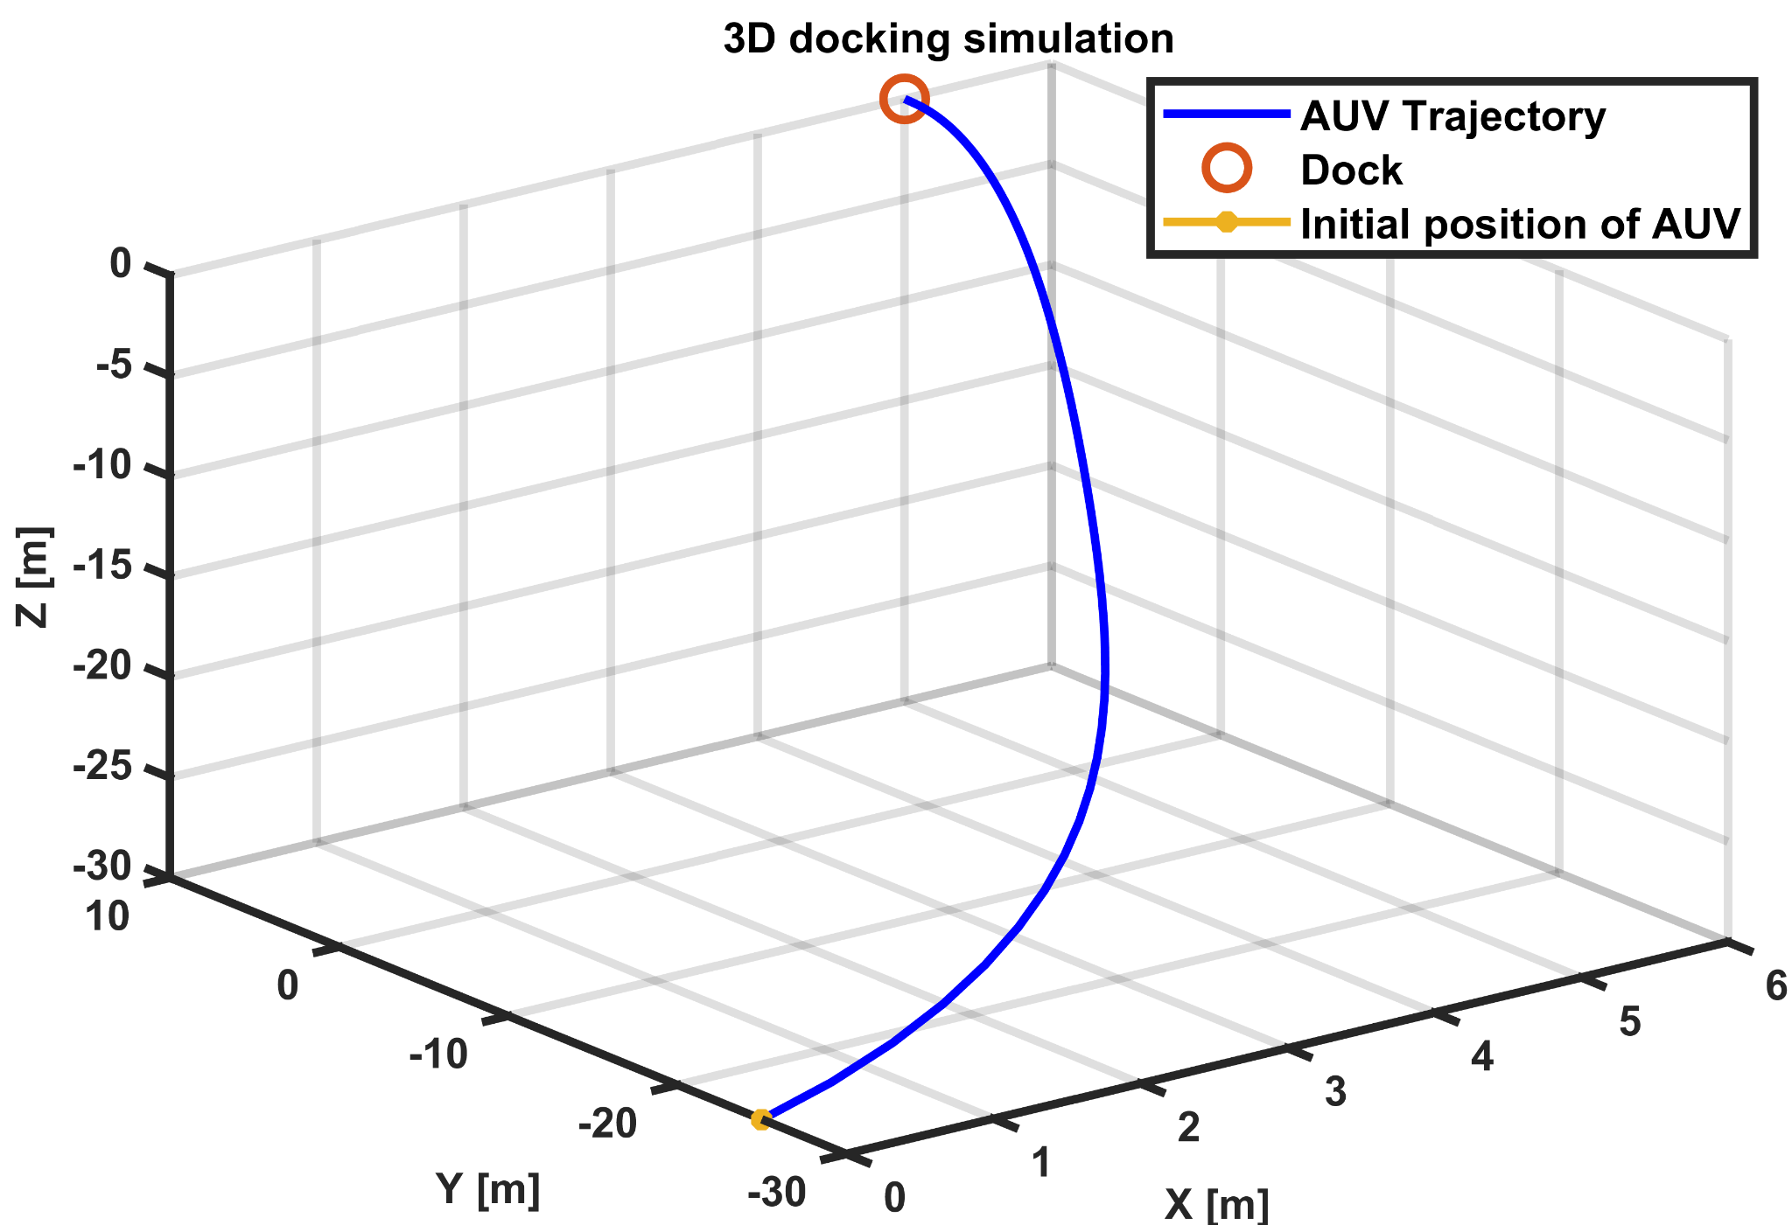
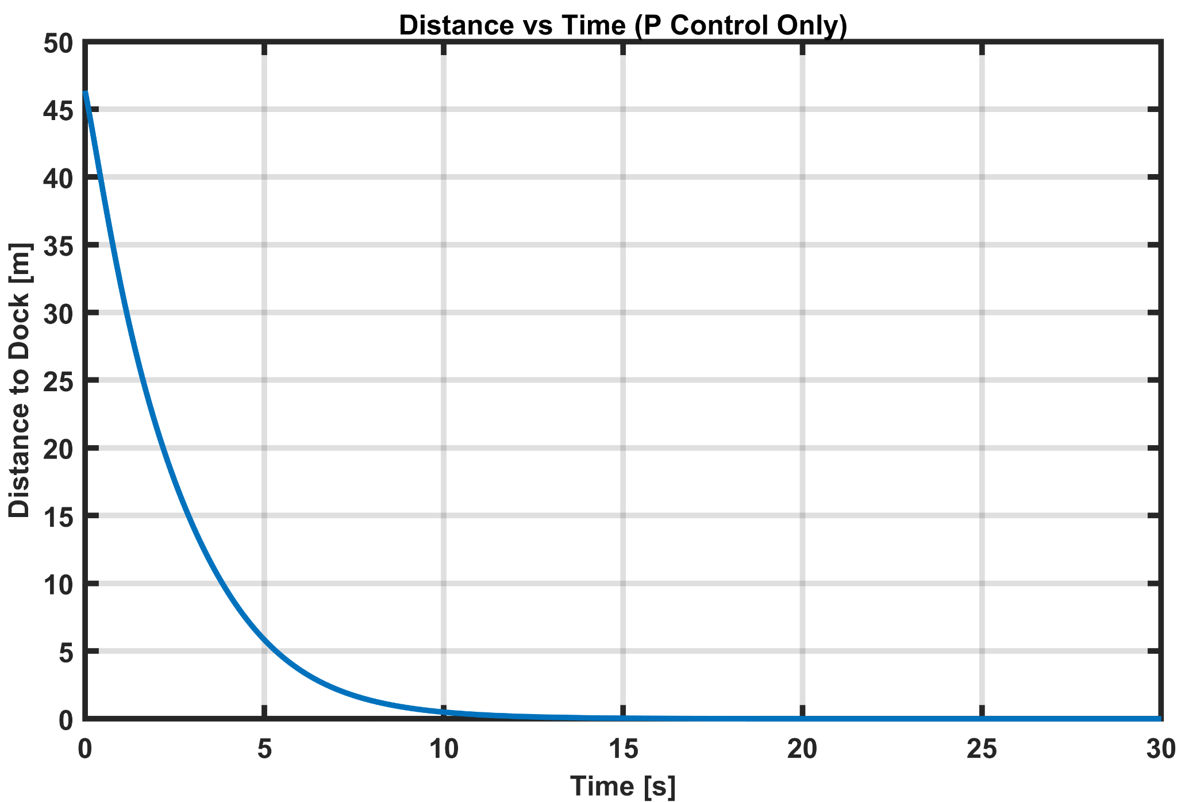
PRELIMINARY SIMULATIONS
These following simulations are made using a proportional controller for the Docker being stationary.
ECS 418 Intelligent Robotics

Slide 10
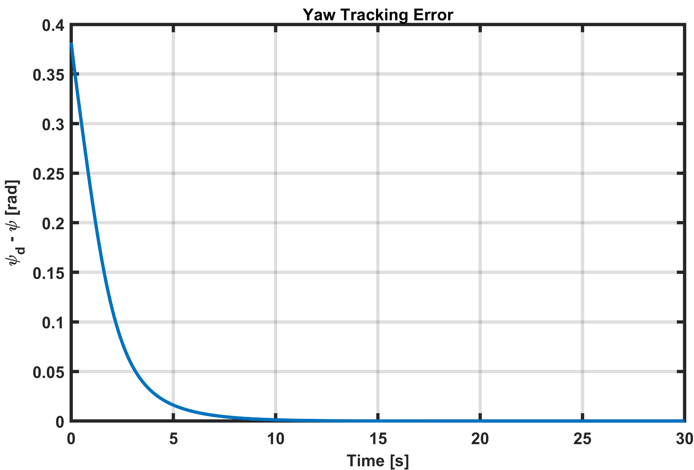
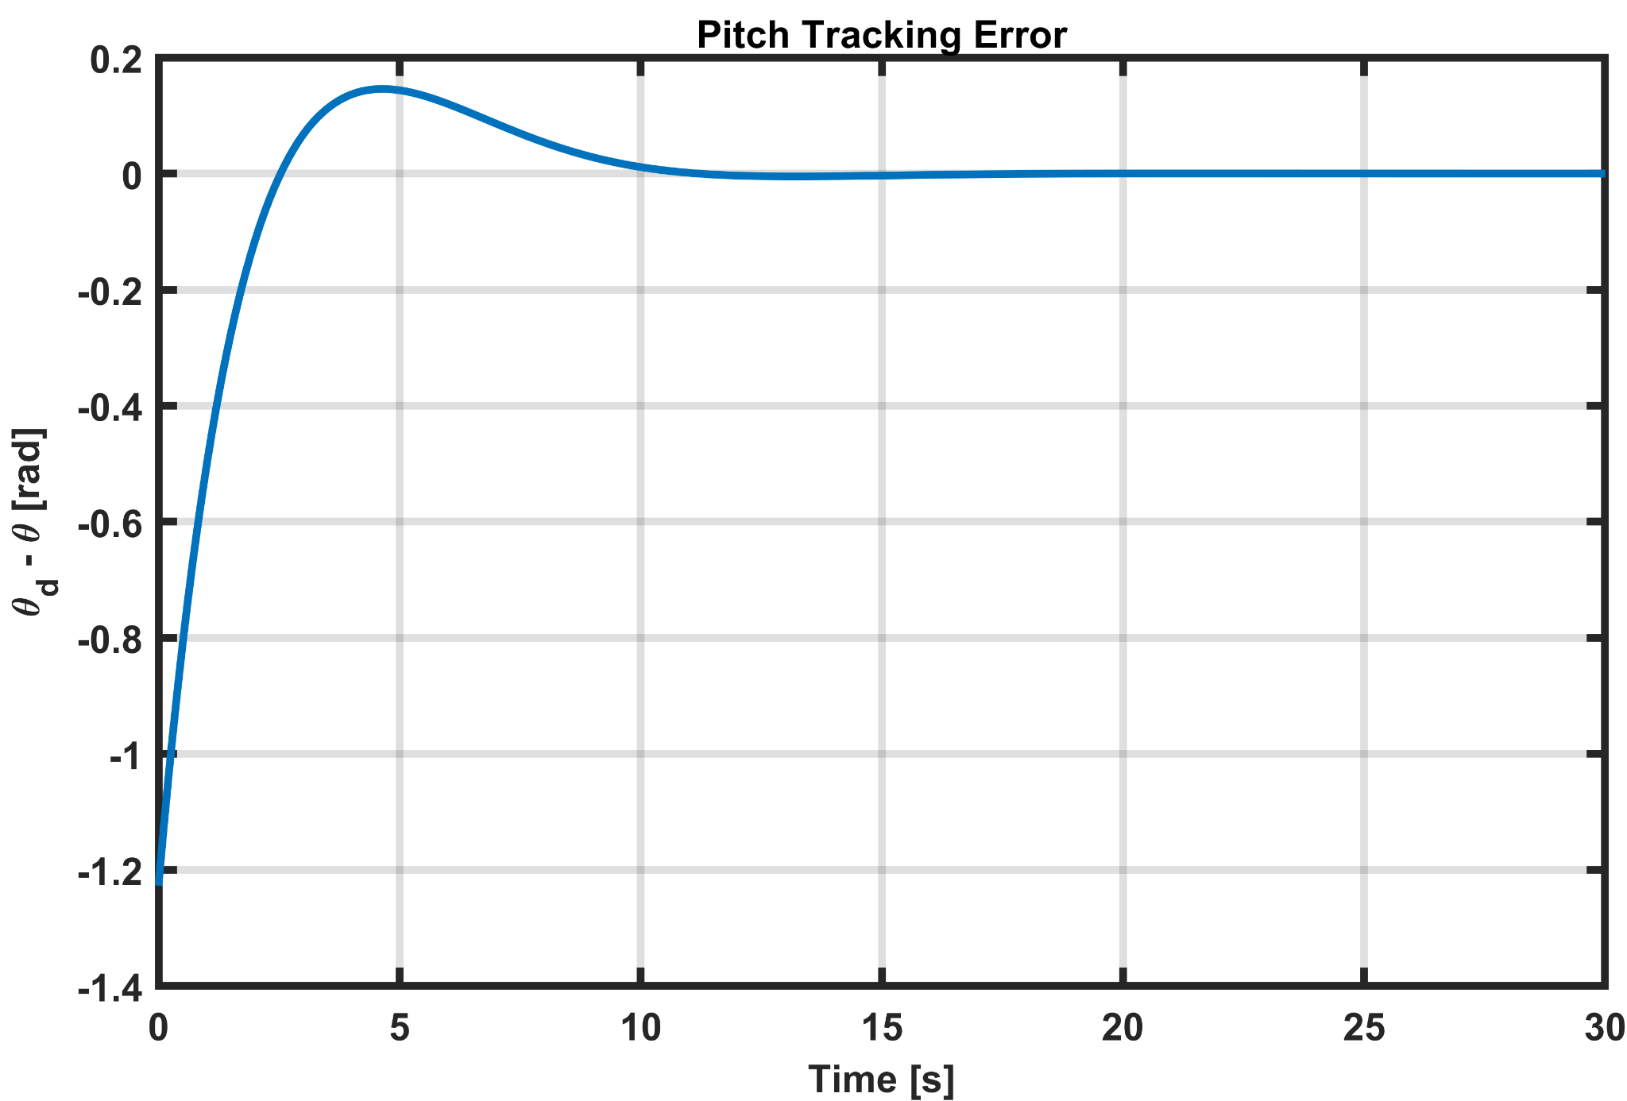
PRELIMINARY SIMULATION RESULTS
ECS 418 Intelligent Robotics

Slide 11
FUTURE PLAN
We aim for finding a control barrier function based docking process for mobile docking where we implement the cardioid function CBF implementing techniques from three-dimensional mobile docking control for slider model.
We modify the controller to account for the disturbances caused by water currents.
ECS 418 Intelligent Robotics

Slide 12
Thank You
ECS 418 Intelligent Robotics

